Slide 1
Nineteenth Century Culture
Tushar Jois
Period 5
Kinberg
AP European History

Slide 2
The Divisions of Culture
Click on a topic to go to that slide, or click anywhere to continue…
Organization
Religion
Literature
Music
Art
Opera
Cultural Life
Public Outreach
Skepticism and the Protestants
The Jews and Catholics
English Novelists
Impressionism
Russian Novelists
French Novelists and Naturalism
Romanticism and Nationalism
Innovations
Post-Impressionism
Fauvism, Cubism, and Sculpture

Slide 3
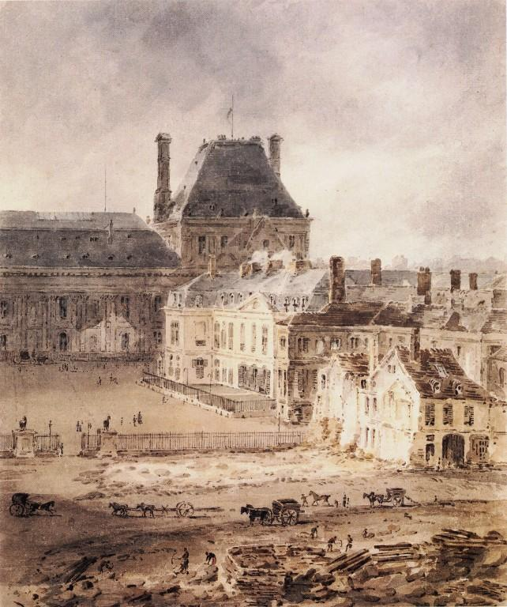
Cultural Life
Before: most works of art, music were commissioned by wealthy patrons for special occasions
Now:
Pieces of music were created to be played at various venues (churches, palaces, concert halls, salons, etc.)
Artists sold their works of art to either a private purchaser or a gallery
A Theater could be the great drama stage or an opera house
Most cities had sponsored orchestras and choirs
Cultural institutions were revered as national monuments
Louvre (Paris), model art museum, provided chronology and country of origin to help people make sense of art
Two functions of cultural life: national identity and social status
Dominated by bourgeoisie (upper middle class)
Enjoyed things like fine dining, concerts which were previously unavailable to them
Separated the middle class from those below them (Chambers 730-731)
All about the synthesis of all forms of culture
The Louvre in 1802 (Girtin).
Notes:
Chambers
Vialut

Slide 4
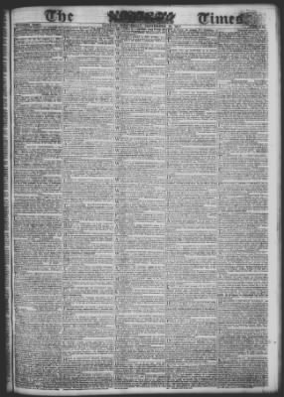
Public Outreach
Most important cultural institution: the press
Newspaper became key in culture, politics
Two thousand European newspapers
Governments tried to control this force via censorship, taxes, public measures
Times (London): 1815 circulation = 5,000; 1850 circulation = 50,000 (10x increase)
Presse and Siècle (France): 1850 circulation = 70,000
Newspapers began to rely more on advertising than subscriptions
Published articles on a wider ranger of topics
Included domestic affairs and fashion for women
Serialized novels by famous writers
Telegraph adopted by press services such as Agence Havas and Reuters for instant reporting
Magazines
First picture magazine: London Illustrated News, 1842
Satirical magazines made cartoons political weapons
Caricatures of Honoré Daumier satirized fat bankers and the submissive bourgeoisie (Chambers 731)
The Layout of the Times during the nineteenth century (The Times).

Slide 5
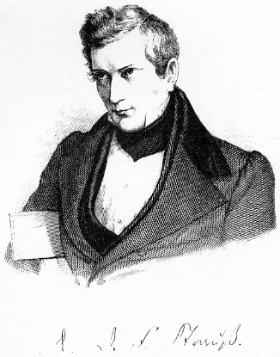
Skepticism and the Protestants
Skepticism in religion–causes
Cult of Science: the belief that science held the answers to all of humanity's questions
Started as a result of Darwin’s theory of evolution
Higher Criticism: scientific scholarship applied to the study of the Bible and early Christianity
David Friedrich Strauss (1808-1874): German Lutheran scholar, doubted Gospels and rejected divinity of Jesus Christ (Life of Jesus, 2 vols., 1835-36)
Ernest Renan (1823-1892), French author of a different Life of Jesus (1863), rejected belief that Jesus preformed miracles or was raised from the dead
Protestant Reactions to the New Ideas
Fundamentalists: insisted on the literal truth of the Bible, rejected any scientific, scholarly ideas that contradicted the Bible
Modernists: liberal Protestants, accepted science and higher criticism, modified their own religious ideas
Other Protestants sought a compromise between religion and science, where the interpret the Bible in figurative terms where it contracted scientific teaching (Viault 341)
Dr. Strauss (Evans).

Slide 6
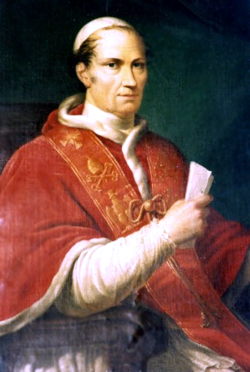
The Jews and Catholics
Jewish Reactions
Orthodox Judaism: maintained traditional religious beliefs and practices
Reform Judaism: the Jewish equivalent of Modernism
Conservative Judaism: wanted to maintain essentials of Jewish tradition while acknowledging the validity of modern learning
Roman Catholic Reactions
Pope Pius IX (r. 1846-1878): hostile to new ideas
Presented Syllabus of Errors in his letter, the Quanta Cura (1864), which condemned modern ideas such as liberalism, secularism, and religious toleration
First Vatican Church Council rules papal statements are free of error when speaking on issues of faith and morals (1870)
Pope Leo XII (r. 1878-1903): moderate
Acknowledged validity of modern science, including evolution
Genesis could be understood figuratively in light of the new discovery
Reaffirmed traditional Catholic doctrine, especially of the teachings of St. Thomas Aquinas (Viault 341-342).
Pope Leo XII (Anonymous).

Slide 7
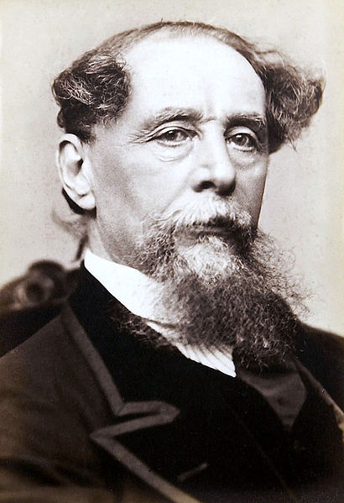
English Novelists
The novel was the literary form of the century
Portrayed the entire spectrum of human nature, the “human comedy”
Used social archetypes to question modern social and moral issues
Most common theme: the conflict between personal feeling and society’s expectations
Dominant form: realism
Realistic images of society, especially ordinary people
Could be very direct, in order to present social problems (Chambers 731-732)
English Novelists
William Makepeace Thackeray (1811-1863)
Vanity Fair (1848): revealing portrait of London bourgeois society at the beginning of the century
Charles Dickens (1812-1870)
Demonstrated elements of Romanticism and Realism
Critical of the bourgeoisie, who were rising in power
Revealed the hardships of the first generation of industrial workers
Novels included Oliver Twist (1838), David Copperfield (1850), and A Tale of Two Cities (1859)
Thomas Hardy (1840-1863)
Much less sentimental compared to Dickens, believed that humans are victims of fate
Novels: The Return of the Native (1878), The Mayor of Casterbridge (1886), Tess of the D’Urbervilles (1891), and Jude the Obscure (1895) (Viault 347)
Charles Dickens (Charles)

Slide 8
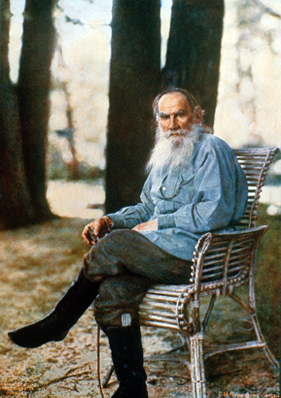
Russian Novelists
The nineteenth century was a golden age for Russian literature
Leo Tolstoy (1828-1910)
War and Peace (1865-69): epic novel set during the time of Napoleon’s invasion of Russia
Anna Karenina (1875-77): a realistic portrayal of life in the Russian capital, St. Petersburg
Ivan Turgenev (1818-1883)
Fathers and Sons (1861): conflict between the older, conservative Russians, and the younger generation that took up the radical nihilism (existence is useless)
Feodor Dostoyevsky (1821-1881)
Russian nationalist and psychological analyst
Mystical belief that humanity could only by purified through suffering
Novels: Crime and Punishment (1866), The Idiot (1868), and The Brothers Karamazov (1879-80)
Anton Chekhov (1860-1904)
Wrote plays about the provincial gentry before the first World War
Produced in the Moscow Art Theatre under the direction of Konstantin Stainislavsky (1863-1938)
Plays: The Sea Gull (1896), Uncle Vanya (1899), The Three Sisters (1901), and The Cherry Orchard (1904) (Viault 348)
Leo Tolstoy in 1908 (Prokudin-Gorsky).

Slide 9
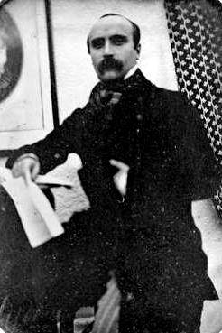
French Novelists and Naturalism
French Novelists
Gustave Flaubert (1821-1880)
Madame Bovary (1857): first great work of literary realism
Scandalous novel that chronicled the adultery of a physician’s wife
Anatole France (1844-1924)
Enjoyed satirizing Christianity and bourgeois society
Novels: The Revolt of the Angels (1914) and Penguin Island (1908)
Naturalism: the focus on social evils in literature
Usually in considerable detail
Really took off in the final years of the nineteenth century
Émile Zola (1840-1902), France
Wrote about the social problems of industrial society
Nana (1880) about prostitution and Germinal (1885) about the miserable lives of coal miners
Henrik Ibsen (1828-1906), Norway
Attacked the values of bourgeois society
A Doll’s House (1879): powerful statement on women’s rights
An Enemy of the People (1882): the story of a town that rebelled against a physician who revealed that the waters of the town’s prized spa were contaminated (Viault 348-349)
Gustave Flaubert (Gustave).

Slide 10
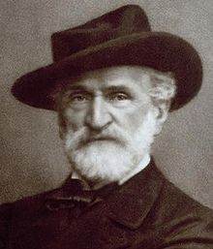
Opera
(Battistini)
Opera was considered the finest of the theatrical arts
Combined popular appeal with an air of elegance
Ballet, colorful set design, and special effects
Elaborate plots, costumes, and music
Two major independent composers
Giuseppe Verdi (1813-1901)
Itallian national hero who wrote music that explored human emotion in a varitey of contexts, but usually those of a historical nature
In Background: a 1906 recording from one of Verdi most loved works, the “O sommo Carlo” from Ernani (1844)
Richard Wagner (1813-1883)
Wrote his text based on Germanic myths to achieve a nationalistic tone
Musical themes recurred with the ideas that recurred
Synthesis of voice, instruments, words, and visuals (Chambers 732)
Portrait of Giuseppe Verdi (Brogi).

Slide 11
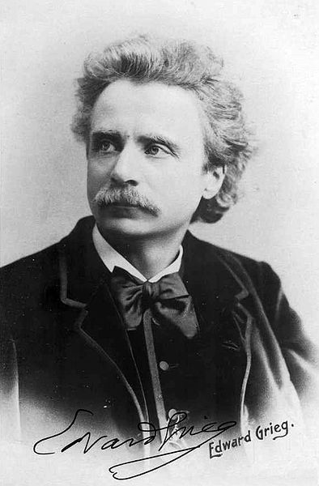
Romanticism and Nationalism
(Tchaikovsky)
Romanticism was prevalent in music well through the end of the nineteenth century
Camille Saint-Saens (1835-1921), France
Wrote in almost every musical form/medium
Characterized by technical polish and skill
Most popular composition: his 1874 Danse macabre, which included the Romantic-Gothic themes of death and decay (“Charles”)
Peter Tchaikovsky (1840-1893), Russia
One of the leaders in Russian romanticism, but felt the need to embed nationalism in his music
In background: “The Dance of the Sugar Plum Fairies” from Tchaikovsky’s best known piece, The Nutcracker Suite Folk music formed the core of nationalist compositions
Edvard Grieg (1843-1907), Norway
Wrote Peer Gynt, based on folk legend, which contains two of the most reconizable modern day pieces – “Morning Mood” and “In the Hall of the Mountain King” (Viault 350)
Portrait of Edvard Grieg (Elliot).

Slide 12
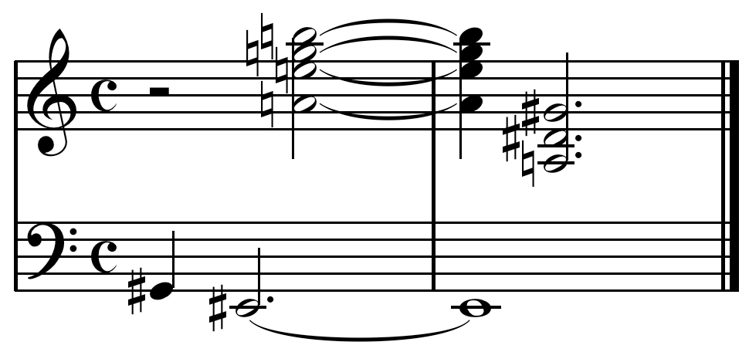
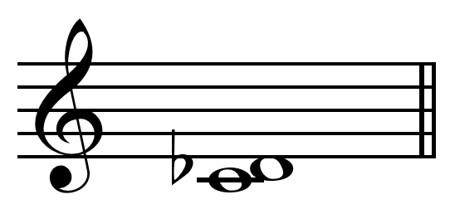
Innovations
Musical innovations
Claude Debussy (1862-1918), France
Applied the Impressionist movement to music
Richard Strauss (1864-1949), Germany
Furthered the concepts of Richard Wagner
Igor Stravinsky (1882-1971)
Experimented with dissonance, the unstable, unpleasant set of notes
Arnold Schoenberg (1874-1951)
Pioneered the development of atonal music, which lacks a tonal center, or key (Viault 350)
Top: the atonal piece from Schoenberg’s “George Lieder” (Last). Left: a dissonance (Minor) .

Slide 13
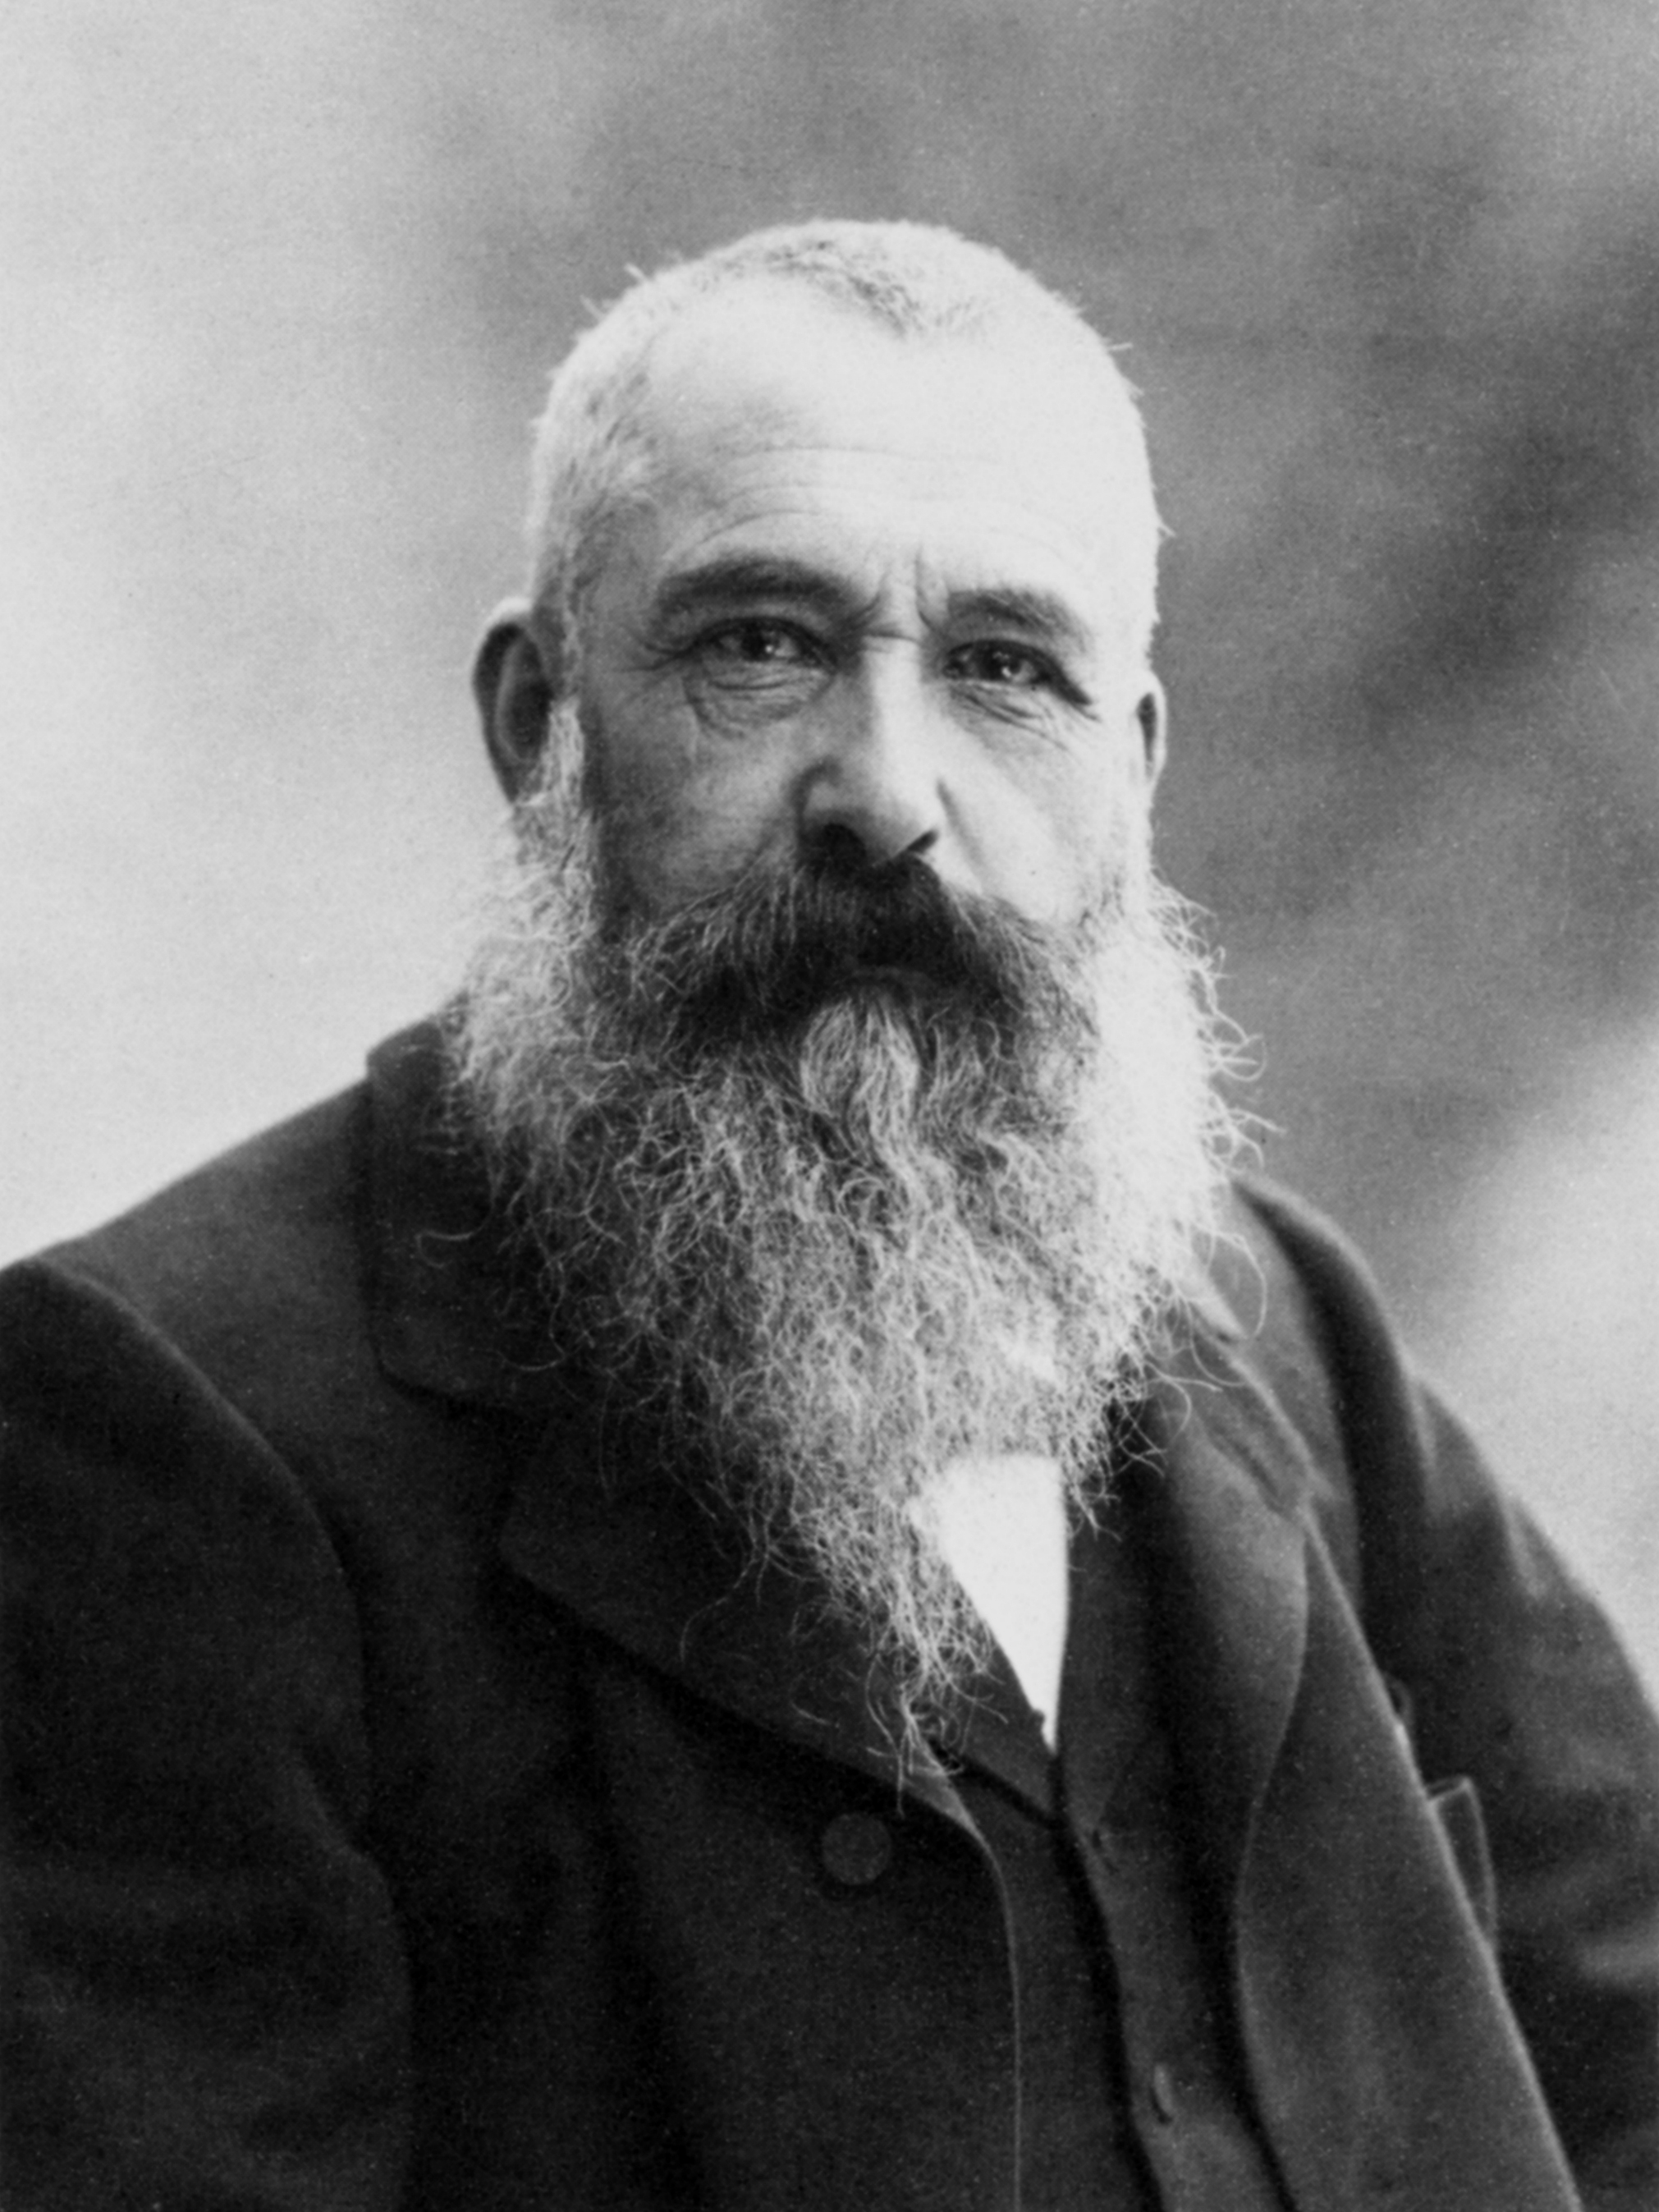
Impressionism
Impressionism consisted of accurate, brightly colored representations of familiar sites at specific moments
They reflected the naturalism that was the norm in literature, a sense of a broader realism
Because of its rebellious nature as an art form, it had a rebellious political connotation as a result
The name was coined by the French satirist Louis Leroy following their first exhibition in Paris, 1874
He made fun of Monet’s Impression: Sunrise (1873), and the name stuck
Artists of this style were encouraged to go out en plein air and paint their paintings
Claude Monet (1840-1926), Camille Pissaro (1830-1903), and Alfred Sisley (1839-1899) were the major outdoor painters of the style
Challenged the traditional institution of the studio
Édouard Manet (1832-1917) and Edgar Degas (1834-1917) were the primary urban painters
Painted theatres and the Opéra, along with the materialistic shopping boulevards (Rubin 1109)
Photograph of Monet (Tournachon).

Slide 14
Impression: Sunrise
Monet’s 1872 painting that captures the sprit of impressionism. Note the industrial boats and factories in the background of this natural scene (Monet).

Slide 15
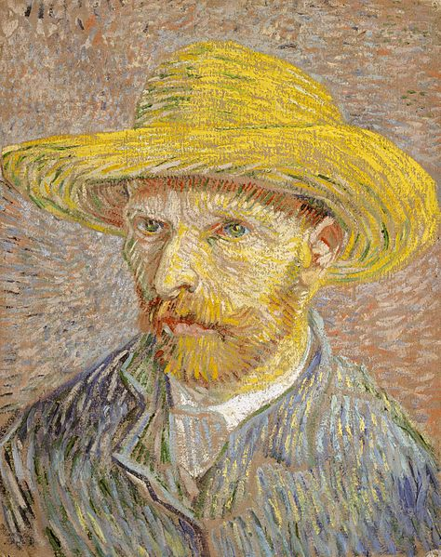
Post-Impressionism
Post-Impressionism refers to everything that occurred as a result of Impressionism
Paul Cézanne (1839-1906)
Used the Impressionist motif of dabs of paint and used Impressionist subject matter, but emphasized the need for formal structure
He wanted to create "a more lasting art, like that of the museums,“ most likely something of a Classical nature (Rubin 1110-1111)
Paul Gaugin (1848-1903)
Frenchman who traveled to Tahiti, and spent his life painting there
Enjoyed painting native women, in their colorful, flowery garb (or lack thereof)
His form is variable, as he depicts some things in accurate detail, and others without detail at all (Eisenman 940-941)
Vincent Van Gogh
Enjoyed expreimenting with color and form, as shown in his self-portrait to the right (Viault 349)
A self-portrait of Van Gogh (Van Gogh).

Slide 16
Montagne Sainte-Victoire
Cézanne’s vision of Impressionism. Notice how even though the painting is attempting to capture a single moment, the trees follow an almost Classical from (Cézanne).

Slide 17
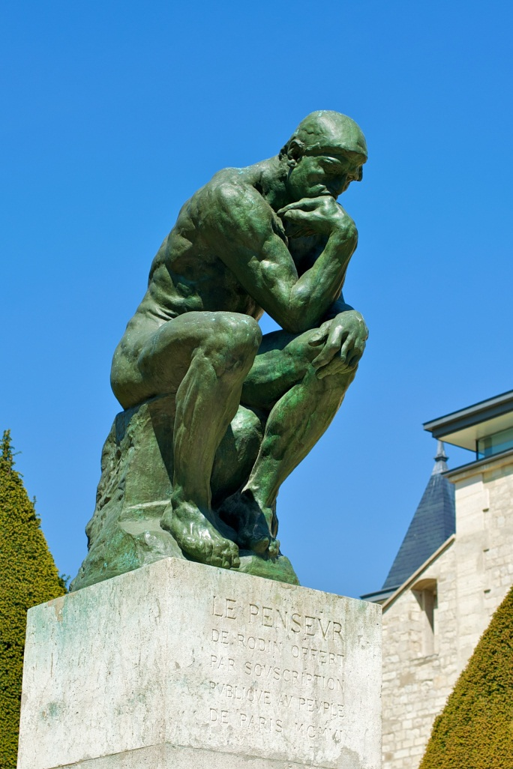
Fauvism, Cubism, and Sculpture
Fauvism
Henri Matisse (1869-1954), France
Characterized by bold and discordant colors
Cubism
Pablo Picasso (1881-1973), Spain
Applied a geometric approach to the portrayal of the human figure
Sculpture
Auguste Rodin (1840-1917)
Introduced Impressionism in sculpture
Works: The Thinker (right), The Burghers of Calais, and statues of Victor Hugo and Honoré de Balzac
The Thinker (Stockman).

Slide 18
Guernica
Perhaps the world’s favorite example of cubism. Note how there are no fully identifiable figures in the entire painting; it is only geometric shapes and figures (Picasso).

Slide 19
Further Research Links
An informative documentary about Impressionism as told by art historian Matthew Collings
Google Art Project – Thousands of Indexed Paintings
Biography.com on Charles Dickens
Stravinsky’s Experiment with Dissonance

Slide 20
Works Cited
Anonymous. Gustave Flaubert. Digital image. Wikimedia Commons. N.p., n.d. Web. 27 Jan. 2013.
Anonymous. Pope Leo XII. Digital image. Wikimedia Commons. N.p., n.d. Web. 27 Jan. 2013. <http://en.wikipedia.org/wiki/File:Pope_Leo_XII.PNG>.
Battistini, Mattia. Battistini-Corsi-Colazza-Sillich. San Francisco: Internet Archive, Nov. 1906. VBR MP3.
Brogi, Giacomo. Portrait of Giuseppe Verdi. N.d. Photograph. N.p.
Charles Dickens. 1868. Photograph. New York.
Cézanne, Paul. Montagne Sainte-Victoire. 1882. Oil on canvas. Metropolitan Museum of Art, New York.
Eisenman, Stephen F. "Gauguin, Paul." Europe 1789-1914: Encyclopedia of the Age of Industry and Empire. Ed. John Merriman and Jay Winter. Vol. 2. Detroit: Charles Scribner's Sons, 2006. 939-941. Gale Virtual Reference Library. Web. 28 Jan. 2013.
Elliott, Joseph J. Portrait of Edvard Grieg. 1888. Photograph. N.p.
Evans, Marian. David Friedrich Strauss. Digital image. Wikimedia Commons. N.p., n.d. Web. 27 Jan. 2013.
Girtin, Thomas. Part of the Tuileries and the Louvre. 1802. Oil on canvas. N.p.
Hyacinth. Last two measures of Schoenberg's "George Lieder" Op. 15/1. Digital image. Wikimedia Commons. N.p., n.d. Web. 27 Jan. 2013.
Hyacinth. Minor second on C. Digital image. Wikimedia Commons. N.p., 12 July 2010. Web. 27 Jan. 2013.
Monet, Claude. Impression: Sunrise. 1872. Oil on canvas. Musée Marmottan Monet, Paris.
Mortimer, Chambers. The Western Experience. 9th ed. Vol. 2. New York: McGraw-Hill, 2007. Print.
Picasso, Pablo. Guernica. 1937. Oil on canvas. Museo Reina Sofia, Madrid.
Prokudin-Gorsky, Sergey. Lev Tolstoy in Yasnaya Polyana. 1908. Photograph. Журнал "Записки Русского технического общества", n.p.
Rubin, James H. "Impressionism." New Dictionary of the History of Ideas. Ed. Maryanne Cline Horowitz. Vol. 3. Detroit: Charles Scribner's Sons, 2005. 1109-1111. Gale Virtual Reference Library. Web. 27 Jan. 2013.
Stockman, Daniel. Le Penseur. 2010. Photograph. Paris.
Tchaikovsky, Peter. "Dance of the Sugar Plum Fairies." Famous Classics. Kevin MacLeod. 2006. MP3.
The Times. Digital image. Fold3.com. N.p., n.d. Web. 27 Jan. 2013. <http://img4.fold3.com/img/thumbnail/28037134/400/400/0_0_5200_7251.jpg>.
Tournachon, Gaspard-Félix. Claude Monet by Nadar. 1899. Photograph. N.p.
Van Gogh, Vincent. Self-Portrait with Straw Hat. 1887. Oil on canvas. Metropolitan Museum of Art, New York.
Viault, Birdsall S. Modern European History. New York: McGraw-Hill, 1990. Print.

